Slide 1


Global Climate Change
Week 11 - Revision
Thomas Bannan

Slide 2
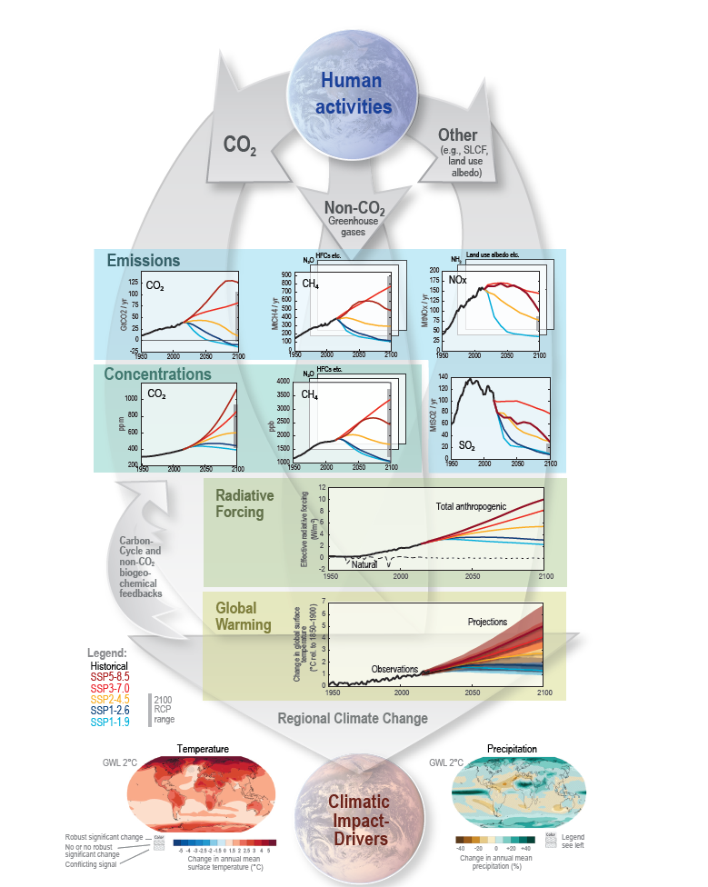
Week 1 – Climate Change and its Impacts
Week 2 – Natural Climate Variability
Week 3 – Radiation Law/Greenhouse Effect
Week 4 – Anthropogenic Impacts
Week 5 – The Evidence Base
Week 7 – Climate Models
Week 8 – Climate Change Adaptation
Week 9 – Climate Change Mitigation
Week 10 – Climate Engineering

Slide 3
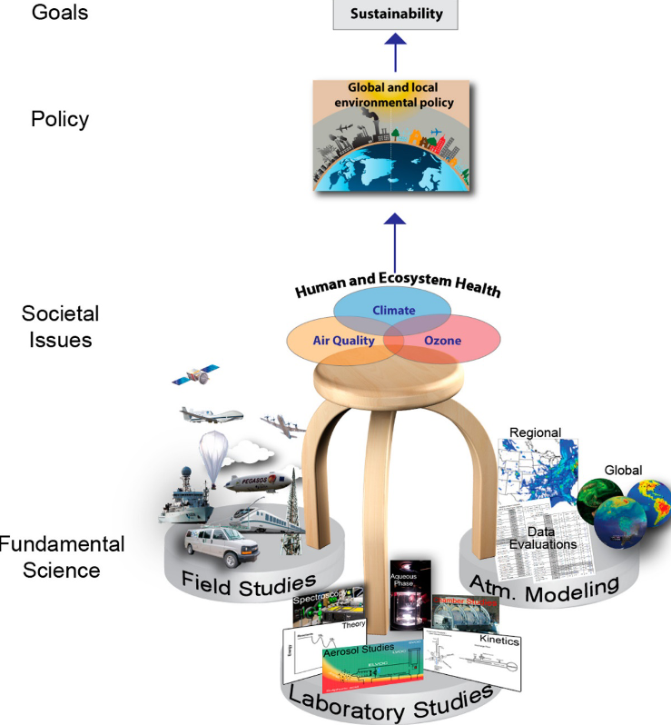

Slide 4
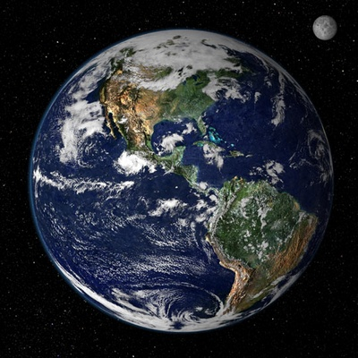
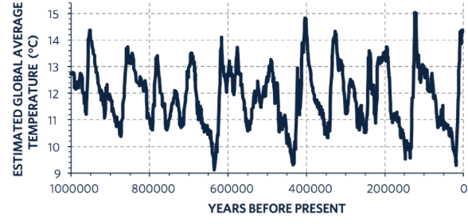
Natural Variability In Climate

Slide 5
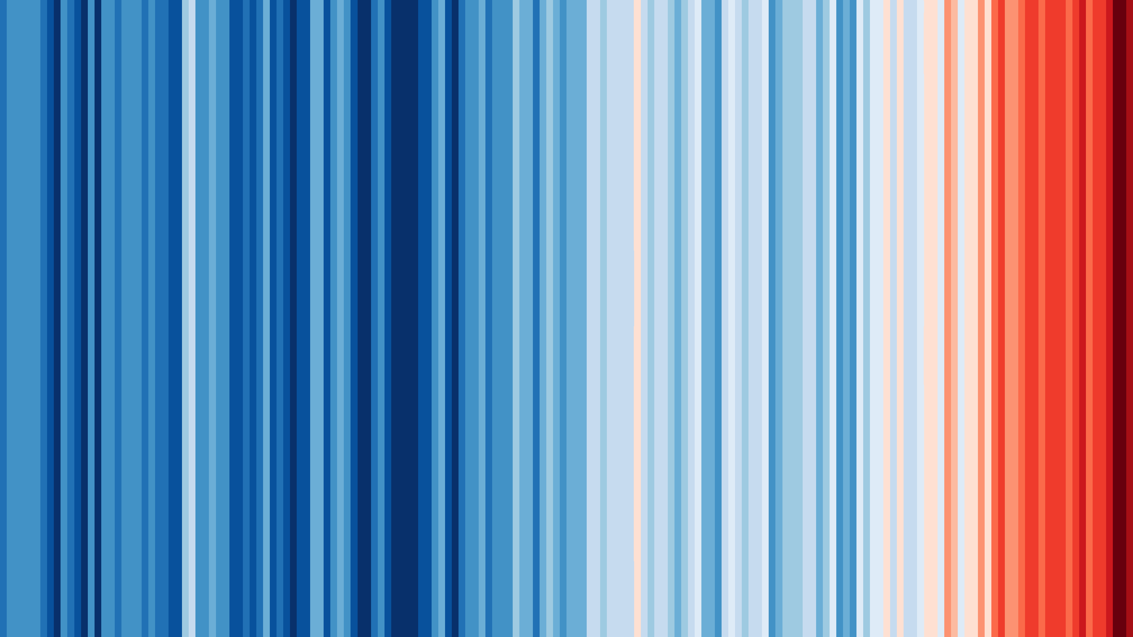

Slide 6
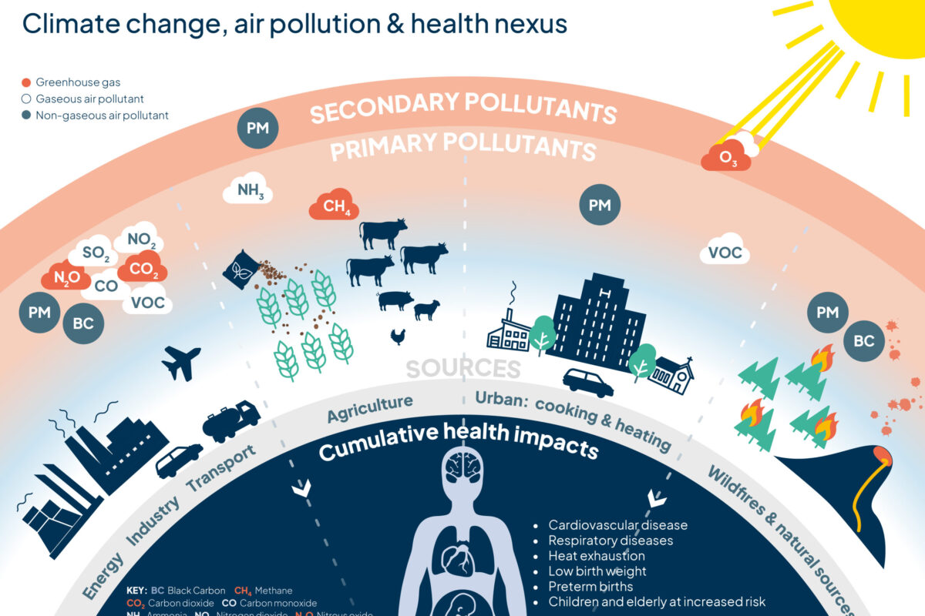
Climate Change Vs Air Quality
We know that air quality is important
We know that climate change is important
We know that these are largely talked about separately
There are significant benefits from tackling poor air quality and climate change in parallel
Like carbon dioxide (CO₂) and methane, air pollutants come from burning fossil fuels, whether from driving cars, generating electricity, or operating industrial plants.
The impacts of climate change exacerbate air pollution. For example, extreme heat increases the number of wildfires which, in turn, release more polluting gases and particulate matter into the atmosphere.
Extreme heat can increase pollution levels and exacerbates the health effects of breathing polluted air.

Slide 7


Slide 8

Last Year’s Paper

Slide 9
Submitted Questions - Scientific grouped
Radiative Balance
Natural Variability
GCMs
Adaptation and Mitigations
Specific Questions

Slide 10
Submitted Questions (practical)
How you expect long answer questions to be structured/ how marks are distributed on these kinds of questions
An example of a long form exam question and how you would expect it answered would be good
Do we need to memorise statistics?
Could we go through good exam answer structure and also how to appropriately reference IPCC data
Are we expected to memorise statistics to provide evidence in our answers in the exam?
Example long answer questions, specifically how to structure answers and what details to include.
Could you maybe go over some approaches for long answer questions & what you expect to see/how much writing you expect for a sufficient answer?

Slide 11
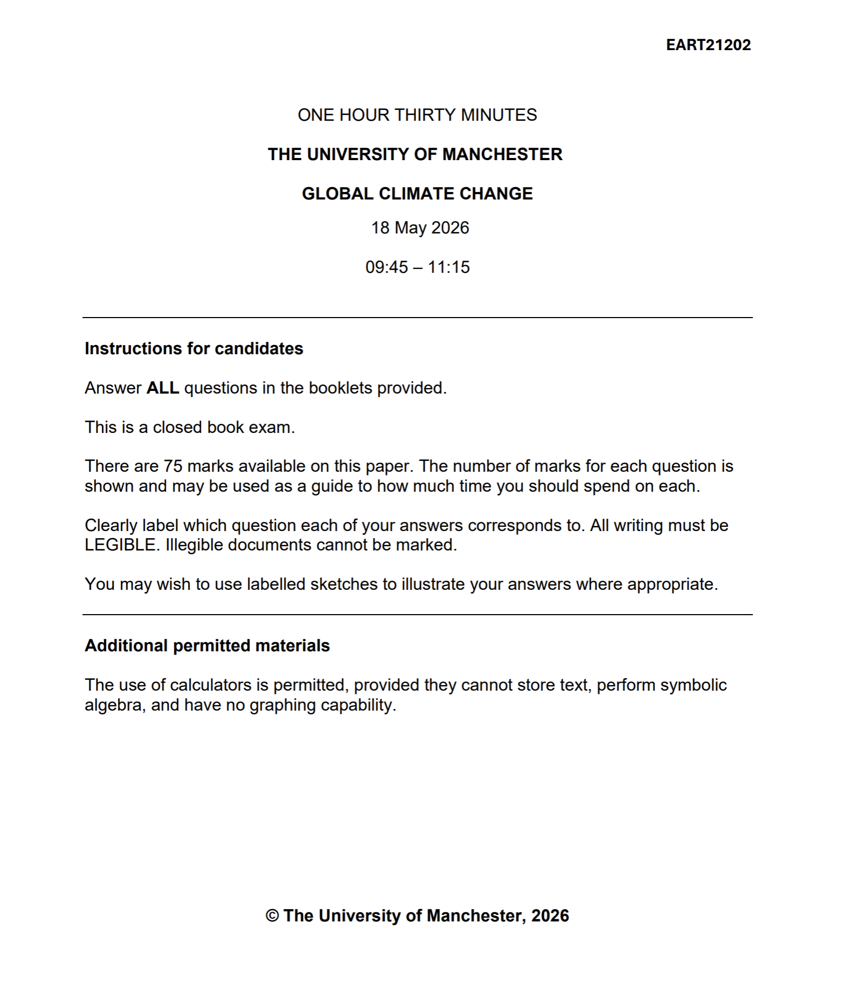
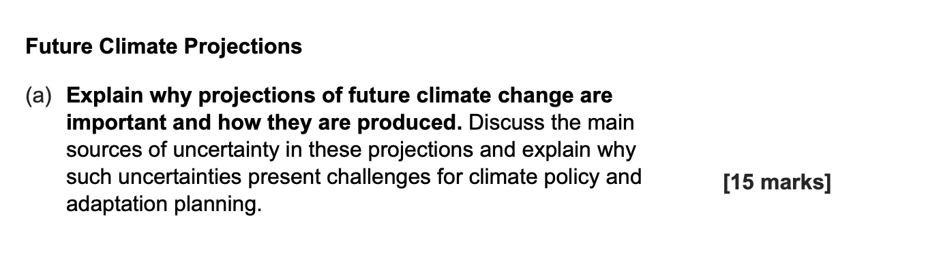
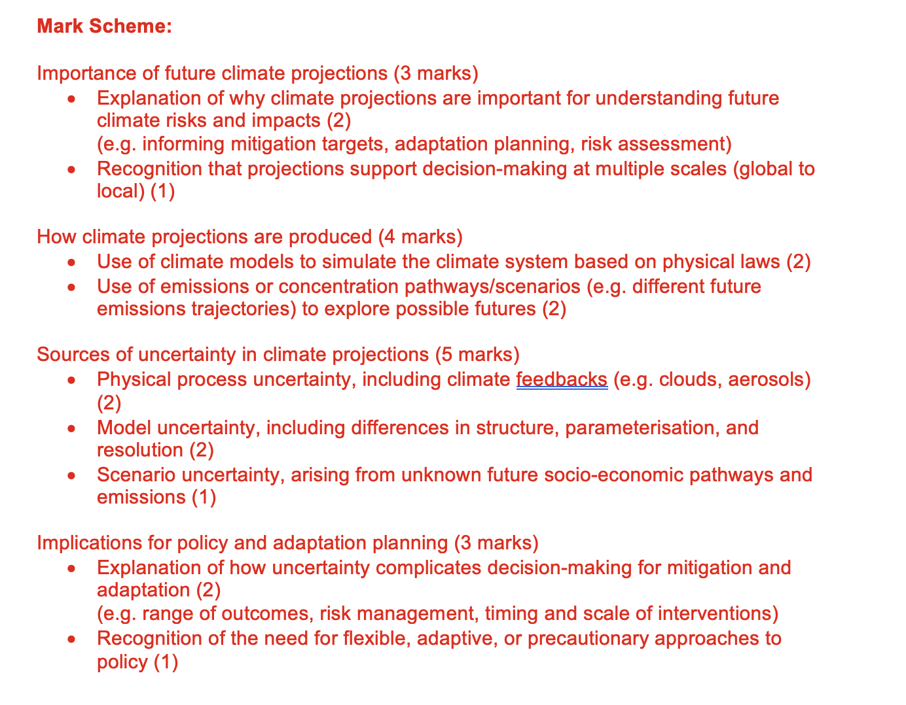
Not needed!

Slide 12
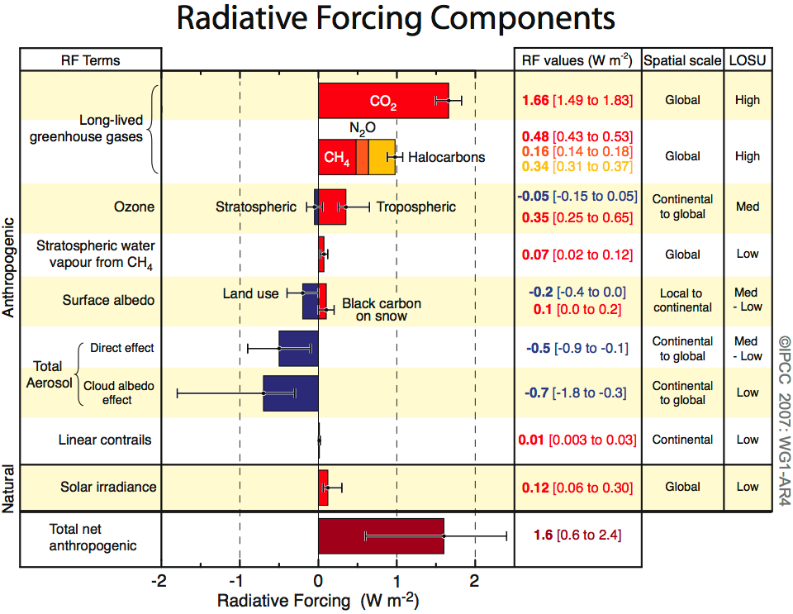
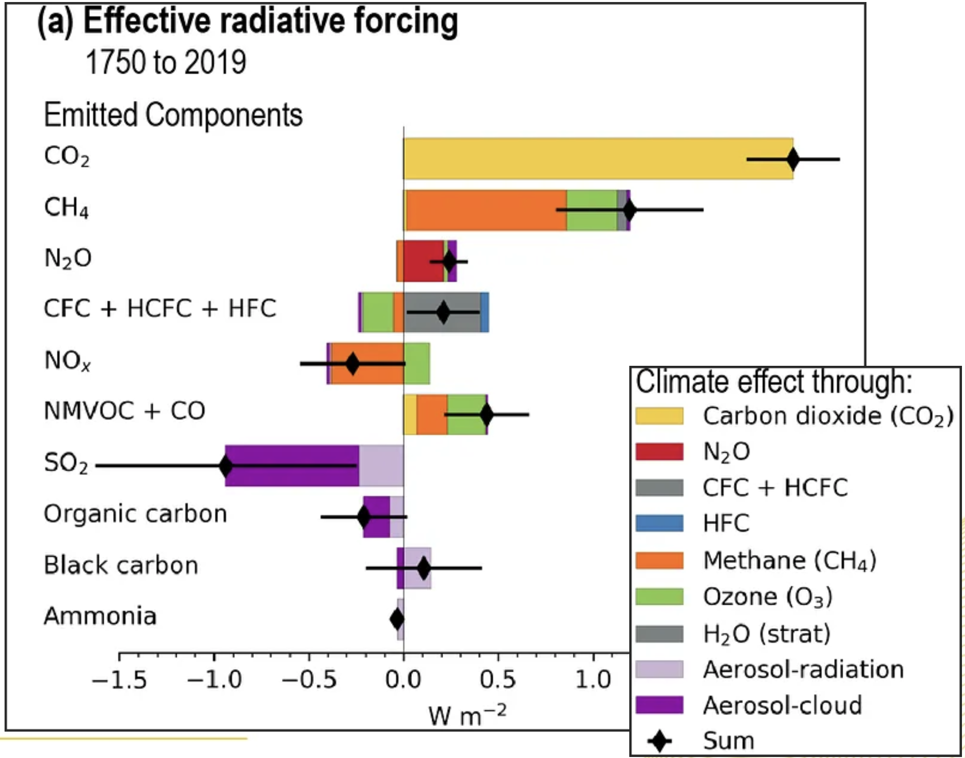
Do we need to memorise statistics?
No but it will improve your mark…….

Slide 13
How to Approach Long Answer Questions
Answer the specific question
  Don’t just write everything you know
Be clear and structured
  Intro: define key terms + outline answer
  Main: explain processes/information step-by-step
Use relevant examples
  No need for memorised statistics but it can help in places if you wish
Write clearly and legibly
  Easy to read = easier to award marks
Focus on quality over quantity
  Clear, relevant explanation matters more than length

Slide 14
Submitted Questions - Scientific grouped
Radiative Balance
Natural Variability
GCMs
Adaptation and Mitigations
Specific Questions

Slide 15
Submitted Questions - Scientific
Radiative Balance
Radiative forcing.
Please can we go over how we calculate radiative forcing
For the revision session: what radiation laws and equations do we need to remember? Revise Earths energy balance (why is there a gap)?
The radiative law and how to do the equations for the final lecture
Could you possibly go through the theory behind some of the maths components

Slide 16
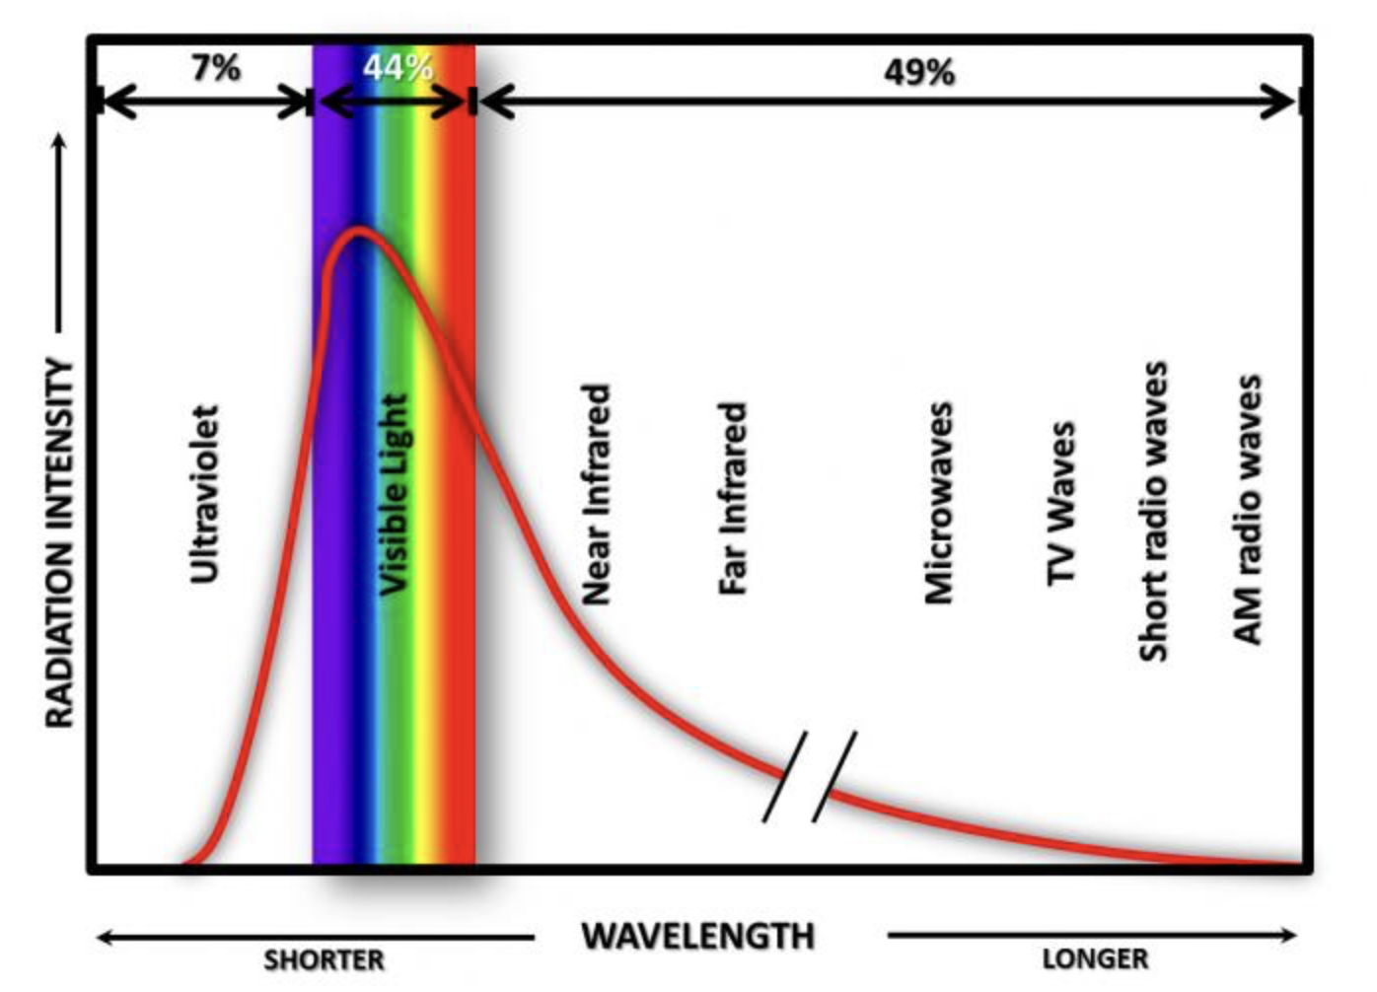
Electromagnetic Radiation
What emits radiation?
  All objects with a temperature greater than 0 K emit some type of radiation (energy)
  This is viewed as an energy spectrum
Radiation laws:
  Warmer objects emit more intensely than cold objects. (Stefan-Boltzmann Law)
  Warmer objects emit a higher proportion of their energy at short wavelengths. (Wien’s Law)

Slide 17
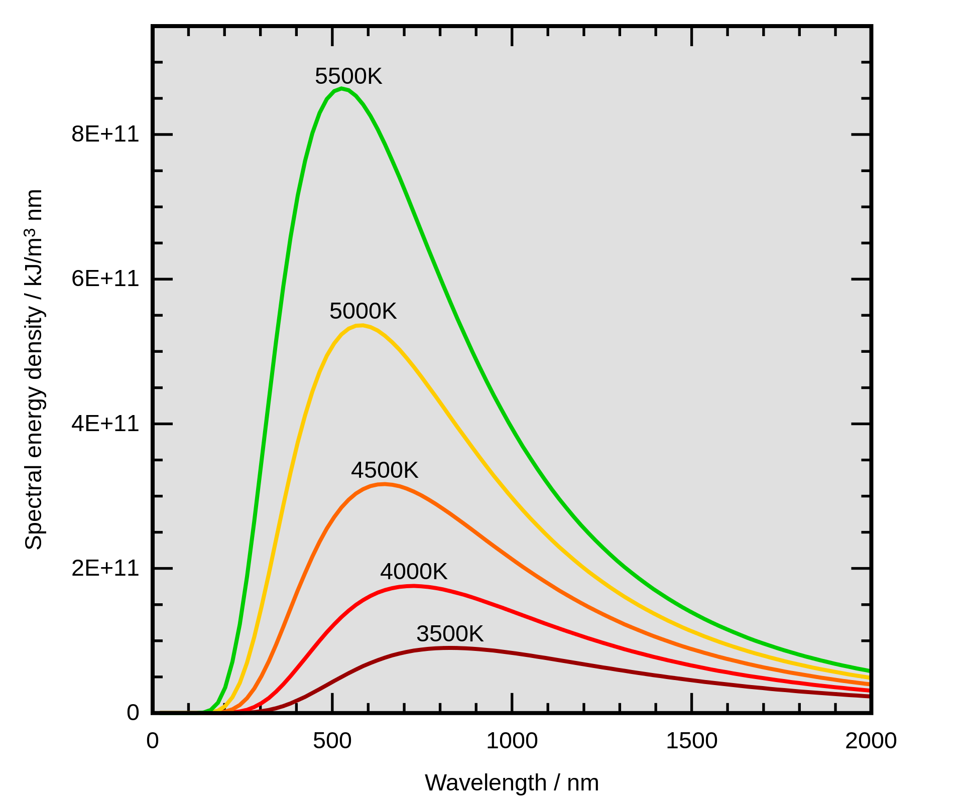
Radiation Laws Combined
As temperature increases:
Total energy increases
Peak wavelength decreases

Slide 18
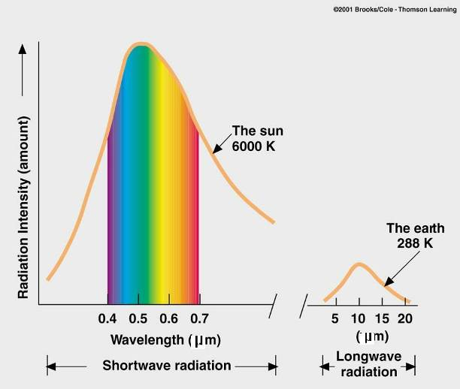
Solar and Earth Spectrums
As temperature increases:
Total energy increases
Peak wavelength decreases
Little overlap between the incoming solar radiation and the outgoing infra-red radiation from the Earth’s surface.
Separated by a gap at around 4 μm
SW
LW

Slide 19
Earth’s Energy Balance
Energy entering top of atmosphere
Energy leaving Earth’s surface
=
Temperature of surface remains constant

Slide 20
Earth’s Energy Balance
What is Radiative Forcing?
RF is the change in Earth’s energy balance
(measured in W m⁻² at the top of the atmosphere)
It represents the difference between:
  Incoming solar radiation
  Outgoing infrared radiation
Positive forcing → warming
  e.g. CO₂, CH₄ (red bars in the figure)
Negative forcing → cooling
  e.g. aerosols reflecting sunlight (blue bars)
The figure shows:
  Their magnitude and uncertainty
  The net anthropogenic forcing is VERY positive

Slide 21
Earth’s Energy Balance
Energy entering top of atmosphere
Energy leaving Earth’s surface
=
Temperature of surface remains constant

Slide 22
Earth’s Energy Balance
Energy entering top of atmosphere
Energy leaving Earth’s surface
=
GHG
What is radiative forcing?
  An effect on Earth’s radiation balance, more specifically:
  The change in radiation balance at the tropopause between the incoming solar radiation and the outgoing earth’s radiation (net irradiance)

Slide 23
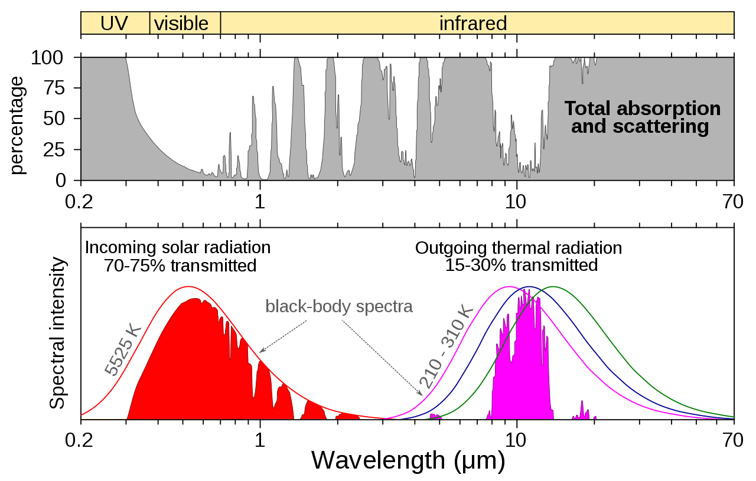
Energy Balance

Slide 24
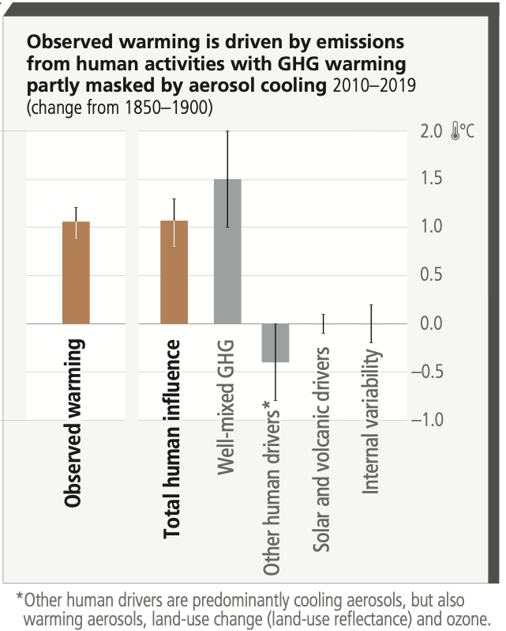
Radiative forcing – how do we know the answer?
Radiative forcing is not measured directly it is estimated using models and observations
Satellite measurements
  Measure incoming solar radiation and outgoing infrared radiation
  Show changes in Earth’s energy imbalance
Surface and atmospheric observations
  Greenhouse gas concentrations (e.g. CO₂, CH₄)
  Aerosols, clouds, and land-use changes
Radiative transfer models
  Use physical laws to calculate how gases and particles affect radiation
  Convert observed concentrations into W m⁻² forcing values
GCMs
  Combine all components (GHGs, aerosols, clouds, etc.)
  Estimate total and individual contributions to forcing

Slide 25
Submitted Questions - Scientific
2. Natural Variability
natural variability recap
Why is natural variability important?
Could we please go over el niño/la niña?
El Nino Southern Oscillation

Slide 26
What drives natural variability in climate?
Orbital Variations
Solar Variability
Volcanic Activity
Ocean Circulation

Slide 27
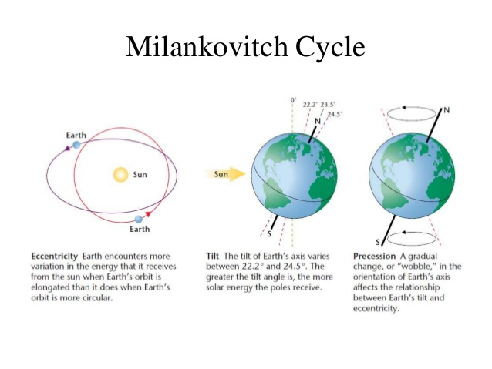
The Milankovitch Cycles
3. Precession
1. Eccentricity
2. Obliquity
Milankovitch cycles interact to modulate the amount, distribution, and seasonality of solar radiation reaching Earth's surface, contributing to long-term climate variability
These cyclical orbital movements, cause variations of up to 25 percent in the amount of incoming insolation at Earth’s mid-latitudes

Slide 28
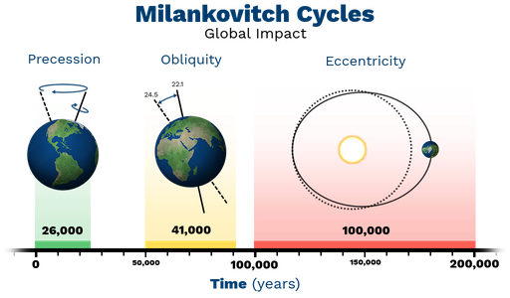
Milankovitch Cycles – The Theory

Slide 29
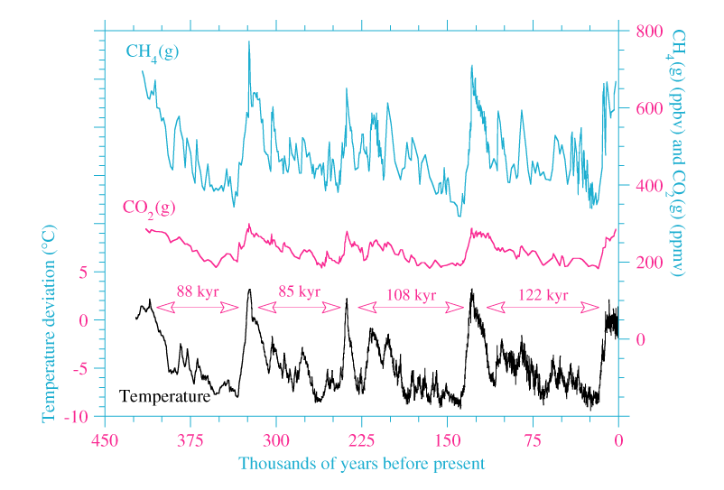
Milankovitch Cycles – Verification
Initially overlooked, Milankovitch’s theory gained recognition after his death
1976 Science study (Hays et al.) linked orbital cycles to climate change using deep-sea sediment cores
Temperature records reconstructed for the past 450,000 years
Ice Ages coincided with specific stages of Earth’s orbital variation
Ice-core data from Greenland and Antarctica further confirmed the cycles
Milankovitch cycles are now widely accepted as drivers of glacial–interglacial timing

Slide 30
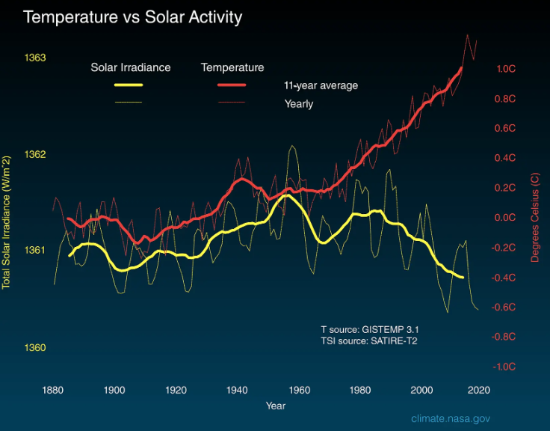
Is the sun causing global warming?
Since 1978, we have been tracking the amount of solar energy that hits the top of the atmosphere using sensors on satellites, which tell us that there has been no upward trend in the amount of solar energy reaching our planet.
If the Sun were responsible for global warming, we would expect to see warming throughout all layers of the atmosphere, from the surface to the upper atmosphere
But what we actually see is warming at the surface and cooling in the stratosphere. This is consistent with the warming being caused by an increase in GHG, and not by the Sun getting “hotter.”
Since 1750, the warming driven by greenhouse gases coming from the human burning of fossil fuels is over 270 times greater than the slight extra warming coming from the Sun itself over that same time interval.

Slide 31
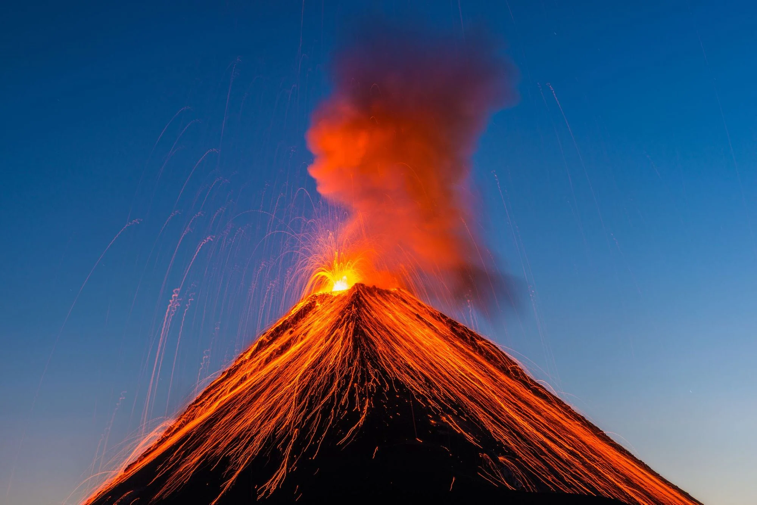
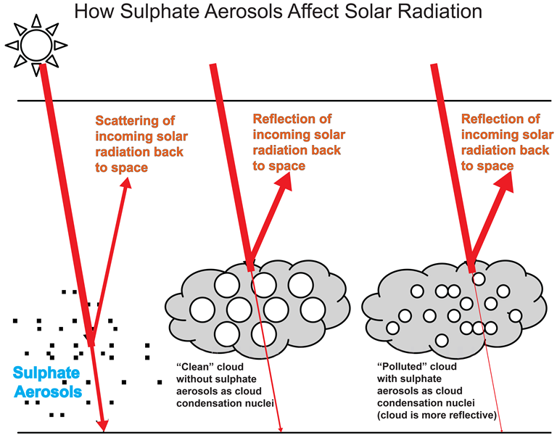
Volcanic Climate Influence

Slide 32
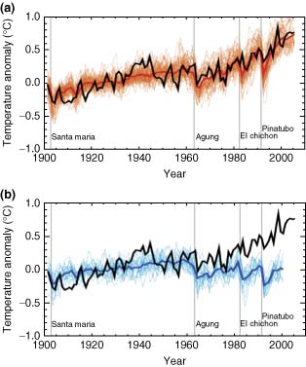
Volcanic Climate Influence
Global average temps reduced by several tenths of a degree following year
Would require succession of eruptions to have a lasting impact.
The eruption of Mount Pinatubo on June 15, 1991, was one of the largest eruptions of the twentieth century and injected a 20-million ton sulfur dioxide cloud into the stratosphere at an altitude of more than 20 miles.

Slide 33
Volcanic Climate Influence
Global effect needs stratospheric SO2
Key point: the climate-active product is sulfate aerosol
STRATOSPHERE: dry + slow removal
reflected SW
Explosive eruptions can inject sulfur dioxide (SO2) above the tropopause.
In the stratosphere, SO2 oxidises to sulfuric-acid/water droplets.
These sulfate aerosols scatter incoming solar radiation back to space.
Result: negative radiative forcing -> surface cooling, plus stratospheric heating.
SO2 -> H2SO4/H2O sulfate aerosol
SO2 injection
tropopause
TROPOSPHERE: rainout is fast
Tropospheric SO2 is mostly washed out; stratospheric sulfate spreads globally and can stay there for longer

Slide 34
Volcanic Climate Influence
Why can the cooling last for years?
SO2 disappears quickly, but sulfate aerosol persists in the dry, stable stratosphere.
Residence time after a large stratospheric eruption
ash
falls out quickly
The eruption may last days, but the aerosol layer can persist for months to a few years.
There is no rain in the stratosphere, so particles are not washed out rapidly.
Small droplets settle slowly and are transported by stratospheric winds around the globe.
One eruption gives temporary cooling; a lasting climate impact would require repeated injections.
SO2 gas
oxidises over weeks
sulfate aerosol
scatters sunlight
surface cooling
Long lived response
Above clouds: little rain scavenging
Slow settling + global winds
Pinatubo example: about 17-20 Mt SO2 reached the stratosphere and produced global cooling for roughly 1-3 years.
days
weeks
months
1-3 years

Slide 35
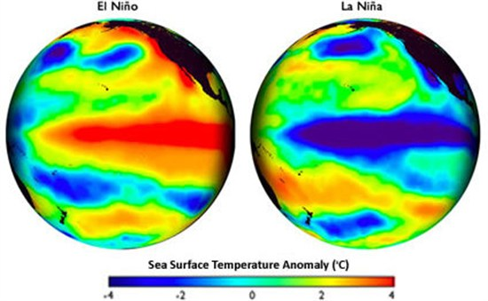
The ENSO (El Nino/Southern Oscillation)
The El Niño-Southern Oscillation (ENSO) is a recurring climate pattern involving changes in the temperature of waters in the central and eastern tropical Pacific Ocean.
On periods ranging from about three to seven years, the surface waters across the tropical Pacific Ocean warm or cool by anywhere from 1°C to 3°C, compared to normal.
This oscillating warming and cooling pattern, referred to as the ENSO cycle, directly affects rainfall distribution in the tropics and can have a strong influence on weather across the United States and other parts of the world.
El Niño and La Niña are the extreme phases of the ENSO cycle; between these two phases is a third phase called ENSO-neutral.
The scale of these fluctuations is vast, changes in sea-surface temperatures often span a distance of more than one-quarter the circumference of the globe, and changes in tropical rainfall and winds span a distance of more than one-half the circumference of the earth.
Notes:
https://www.youtube.com/watch?v=JIdwC1kipGo&t=1187s

Slide 36
Discussion
“The climate has always varied, and it has been hotter than this before - climate change isn’t real”
How do we know this isn’t true – build an argument against this
(10 mins)

Slide 37
Submitted Questions - Scientific
3. Global Climate Models
GCMs coupling and uncertainties.
How to talk about the climate change models in exam questions

Slide 38

Global Climate Models
Question: GCMs coupling and uncertainties.
What is coupled in a modern GCM?
external forcings
GHGs • solar • volcanoes
Coupling means model components exchange fluxes so feedbacks can evolve together.
Atmosphere
clouds, winds
Carbon / aerosols
optional in ESMs
heat
water
A coupled GCM links atmosphere, ocean, land and sea ice modules on different grids/timesteps.
The coupler passes energy, water, momentum and sometimes carbon between components.
This captures feedbacks: ocean heat uptake, sea-ice albedo, clouds and land-surface changes.
Trade-off: more realistic interactions, but more parameters and greater computing cost.
COUPLER
exchanges fluxes
at each time step
Land
soil + water
Sea ice
albedo
momentum
CO2
Ocean
heat uptake
Coupling allows feedbacks: ocean heat uptake | ice-albedo | clouds/aerosols | carbon cycle

Slide 39
Global Climate Models
Question: where do climate model uncertainties come from?
Why do projections come as ranges?
Model uncertainty is a range of plausible answers
relative importance across a projection
internal variability
weather + oceans
matters most for regions/years
Internal variability: large atmosphere-ocean variability; important for short-term/regional changes.
Model uncertainty: different representations of clouds, aerosols, convection, ocean mixing and ice.
Scenario uncertainty: future emissions and land-use choices; grows through the century.
Ensembles compare many models/runs to identify robust signals and quantify spread.
model response
clouds, aerosols, convection,
ocean mixing, ice
future emissions + land use
grow in importance
scenario choices
higher emissions
lower emissions
Highest confidence is in long-term global temperature; rainfall and regional extremes are harder.
near term
mid-century
late century
Ensembles separate the robust climate signal from the spread.

Slide 40
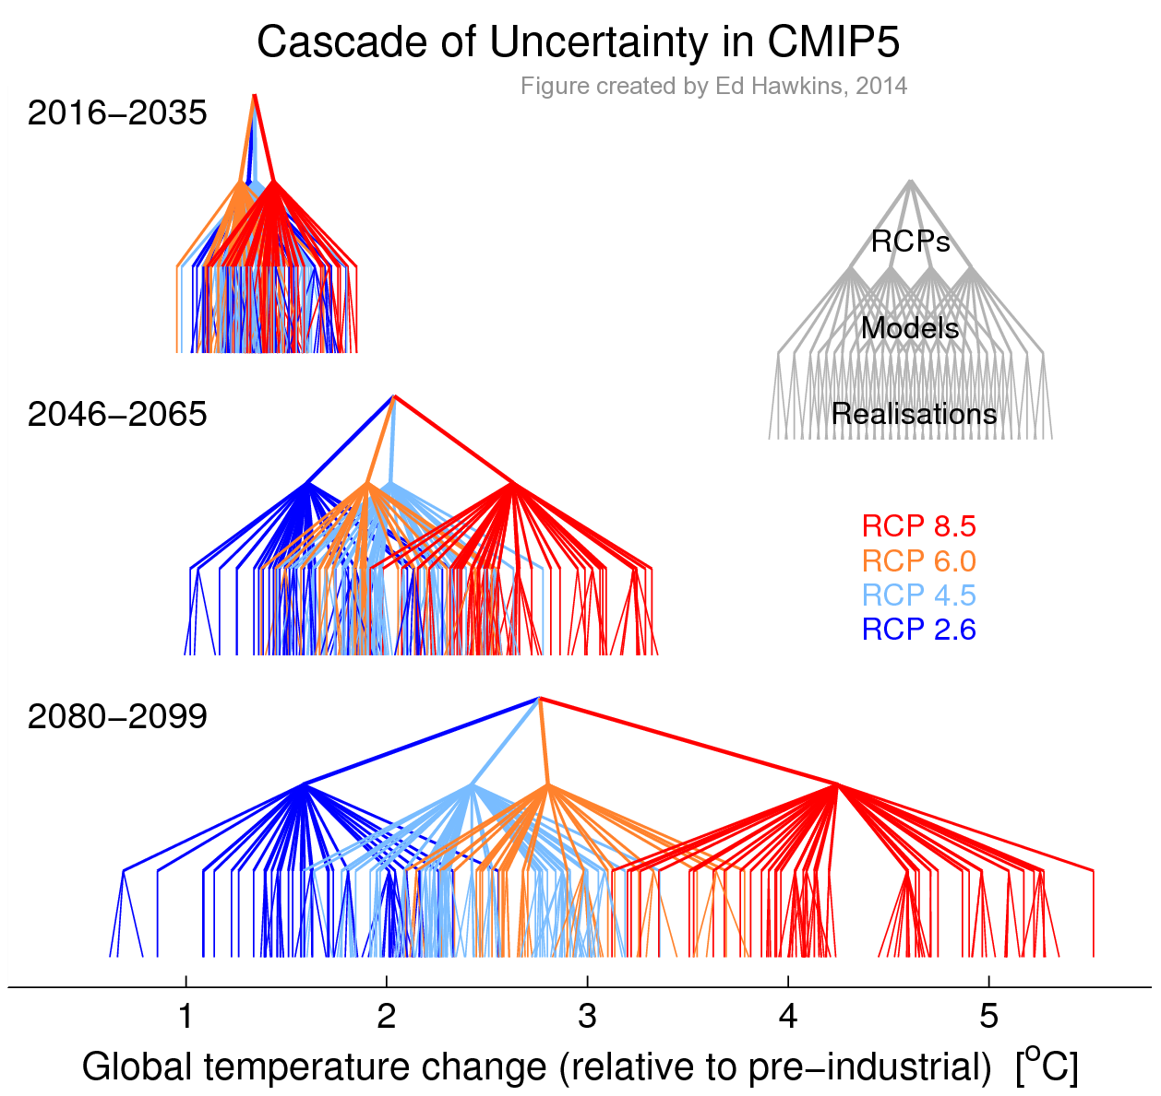
Climate Models - Uncertainties
Week 7

Slide 41
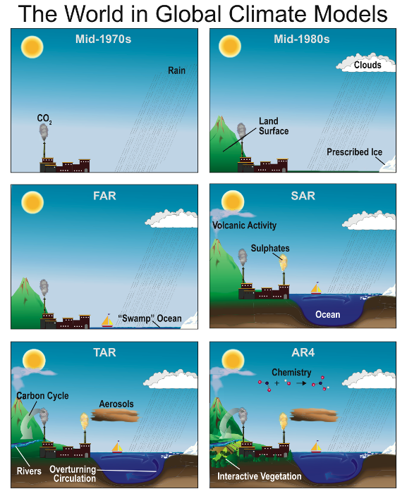
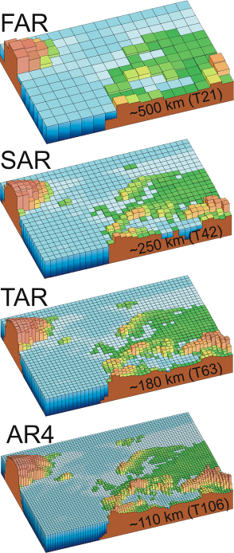
Performance of Global Climate Models
Modern Coupled GCMs
   Perform well at continental scales
   Perform well at multiannual -> climatological scales (30 year)
   Perform less well at short time scales
   Perform less well at regional scales
The complexity of climate models has increased over the last few decades. The additional physics incorporated in the models are shown pictorially by the different features of the modelled world.

Slide 42
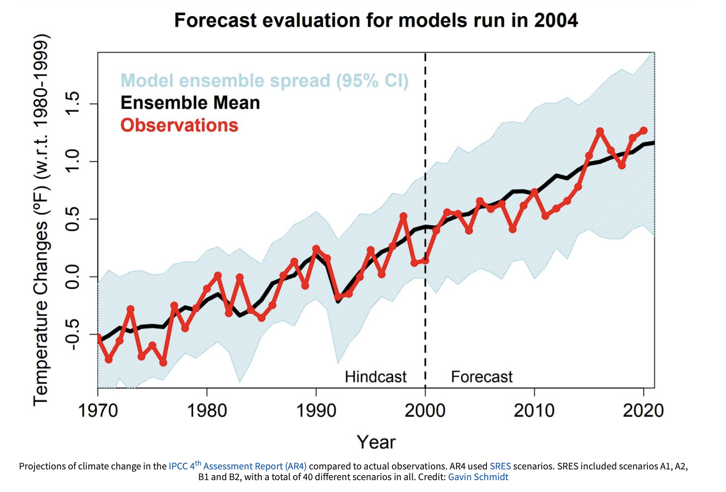
How did we do in 2004?
Observed changes in temperature and precipitation have generally been consistent with the changes projected by earlier models.
The accurate projections of future climate and hindcasting of past climate makes us confident that models can reliably project changes in the climate.

Slide 43

Climate Feedback – Positive Examples
Climate feedbacks describe how components of the Earth system respond to an initial forcing, either reinforcing or counteracting the resulting climate change.
(Processes that amplify an initial climate change)
Ice–albedo feedback
Melting ice and snow reduce surface albedo, causing more solar radiation to be absorbed and further warming.
Water vapour feedback
Warmer air holds more water vapour, a powerful greenhouse gas, which enhances the greenhouse effect.
Ocean carbon feedback
As seawater warms, the oceans’ capacity to dissolve CO₂ decreases, leaving more CO₂ in the atmosphere.
Vegetation–albedo feedback (regional)
Expansion of darker vegetation (e.g. forests into high latitudes) lowers surface albedo, increasing heat absorption.

Slide 44

Climate Feedback – Negative Examples
Climate feedbacks describe how components of the Earth system respond to an initial forcing, either reinforcing or counteracting the resulting climate change.
(Processes that counteract an imposed climate change)
CO₂ fertilisation effect
Higher atmospheric CO₂ can enhance plant growth, increasing carbon uptake through photosynthesis.
Increased terrestrial carbon storage
Warmer temperatures in some regions lengthen growing seasons, allowing greater carbon storage in soils and biomass.
Chemical weathering feedback
Higher temperatures and increased rainfall enhance silicate rock weathering, which removes CO₂ from the atmosphere over long timescales.

Slide 45
Submitted Questions - Scientific
4. Adaptation and Mitigations
More examples/how to differentiate adaptation and mitigation e.g which would building sea walls in coastal areas be?
Climate change adaptation
Do you think any of the mitigation strategies will ever produce a real change to the CO2 levels?
How well does the MCB over the great barrier reef really work? Can it be reproduced cheaply for use elsewhere
There is an air carbon capture system in Iceland, do you know if it is successful and if so where would the best place in UK be?
Is there no process to split the CO2 directly and store the carbon?
What about painting building rooves in the tropics white to reduce a/c electricity usage?

Slide 46
Adaptation and Mitigations
Question: how do we differentiate adaptation and mitigation?
Mitigation tackles the cause; adaptation tackles the consequences.
Mitigation: reduce greenhouse gas emissions or remove CO2, lowering future forcing.
Adaptation: reduce exposure, vulnerability and damage from climate impacts.
Building sea walls is adaptation: it protects against flooding but does not lower CO2.
Some actions do both, such as mangrove restoration or efficient, shaded buildings.

Slide 47
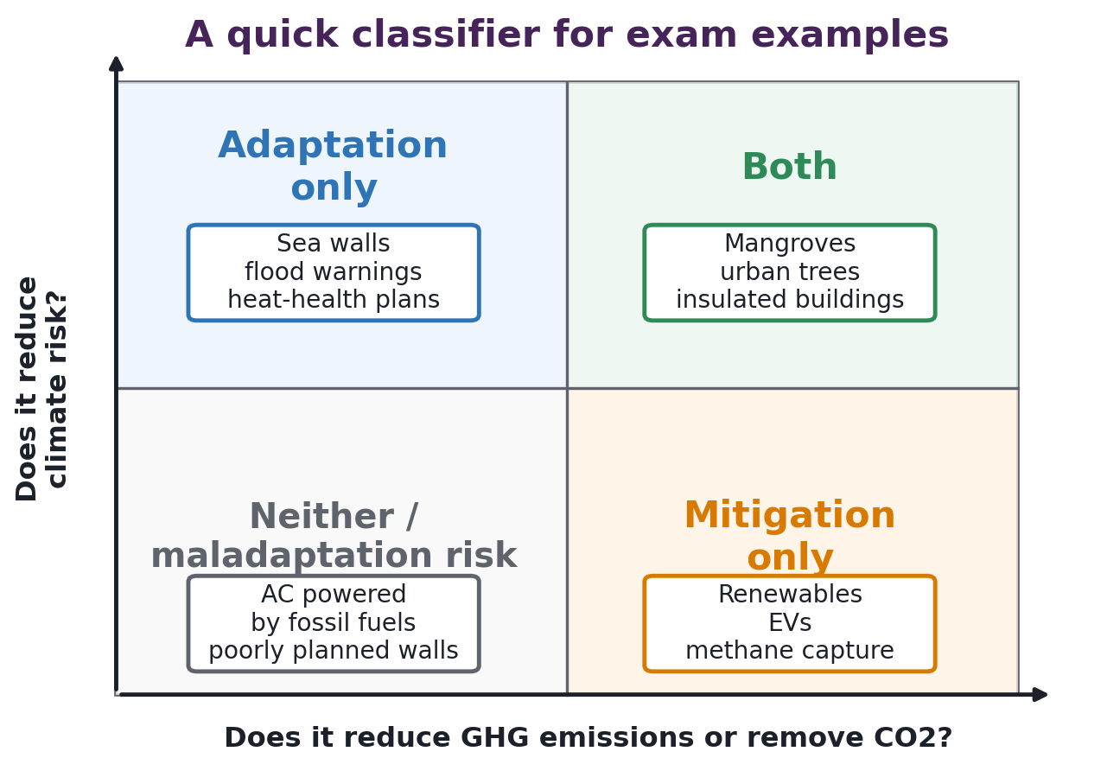
Adaptation and Mitigations
Question: which category do examples fit into?
Use two checks: does it cut emissions, and does it reduce climate risk?
Sea wall: adaptation only - coastal protection from sea-level rise/storm surge.
Renewables, energy efficiency and methane capture: mitigation only.
Mangroves, peatland protection and urban trees can be both, if carbon is durable.
Air conditioning can be adaptation, but may increase emissions if powered by fossil fuels.

Slide 48
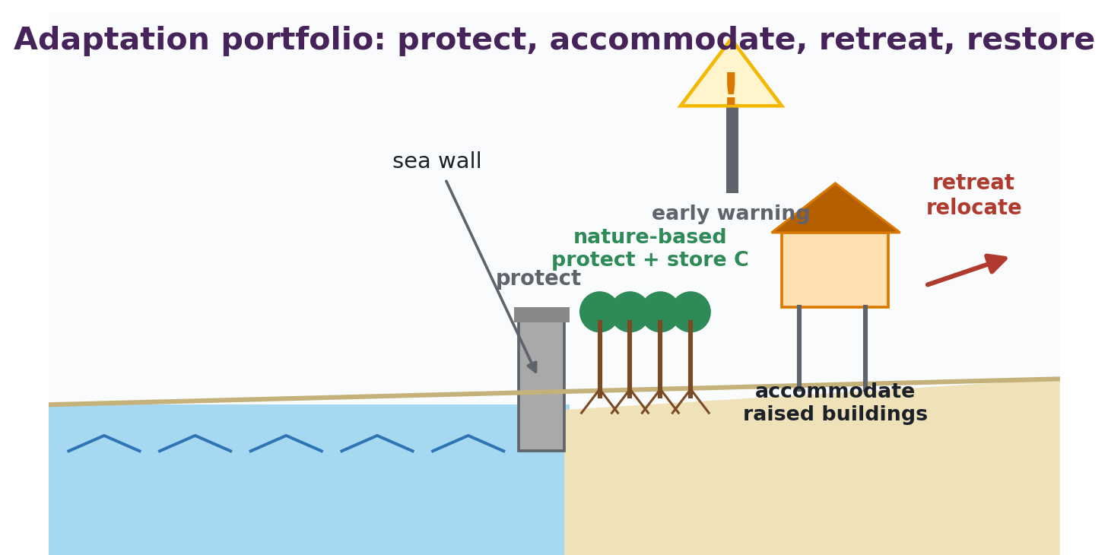
Adaptation and Mitigations
Question: climate change adaptation.
Adaptation is a portfolio - protection, planning and behavioral change.

Slide 49
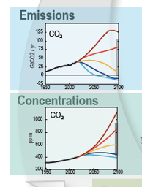
Adaptation and Mitigations
Question: will mitigation ever produce a real change in CO2 levels?
Yes - but CO2 levels fall only when net emissions become negative.
Emissions reductions slow the growth rate of atmospheric CO2 first.
Net zero CO2 stabilises CO2-induced warming; it does not instantly remove past CO2.
Net negative CO2 removals can gradually reduce concentrations and temperatures.
Therefore: mitigation matters because warming depends on cumulative CO2 emissions.

Slide 50
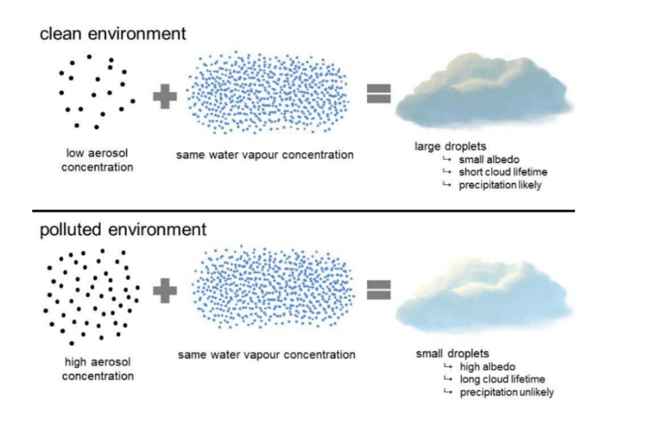
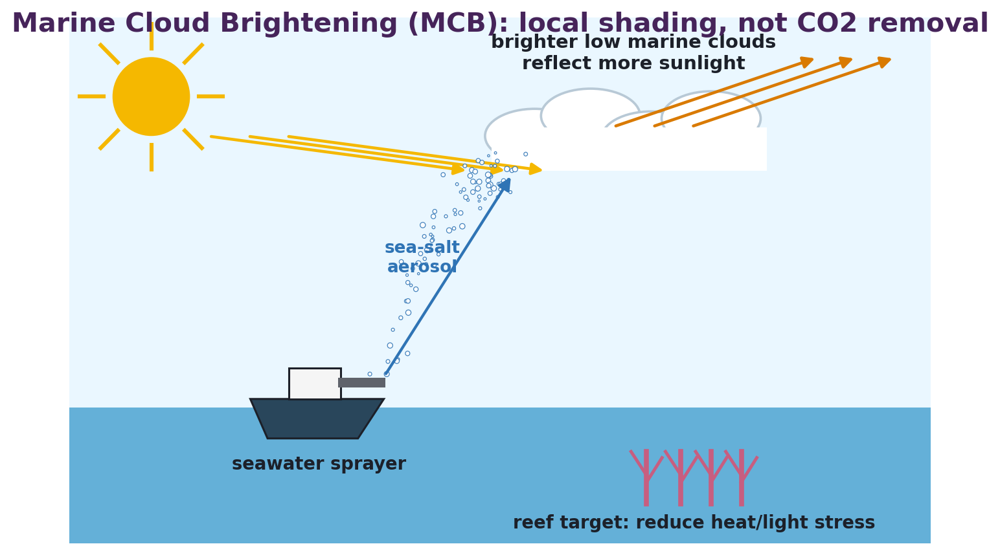
Adaptation and Mitigations
Question: can MCB be reproduced cheaply elsewhere?

Slide 51
Adaptation and Mitigations
Question: can MCB be reproduced cheaply elsewhere?
The ingredients are simple; reliable deployment is site-specific and unproven at scale.
Cheap parts: seawater is abundant and the concept uses natural sea-salt particles.
Expensive parts: sprayers, vessels, power, forecasting, monitoring, maintenance and permissions.
Transferability depends on low marine clouds, wind, target ecosystem and governance.

Slide 52
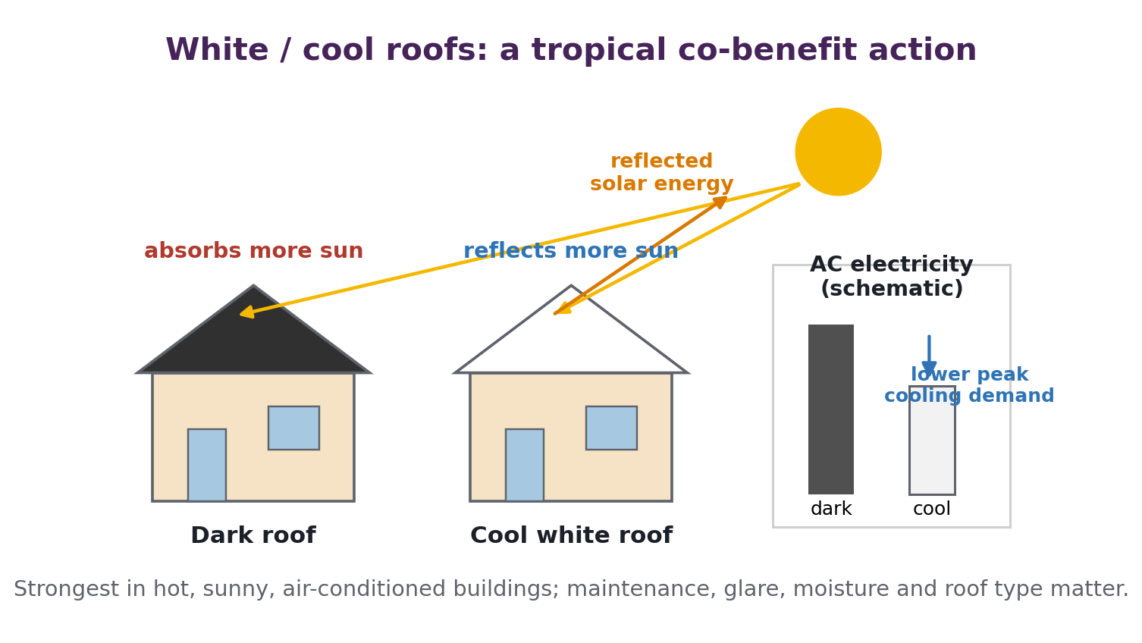
Adaptation and Mitigations
Question: what about painting roofs white in the tropics?
Good idea in hot climates: local adaptation with a small mitigation co-benefit.
Higher albedo roofs reflect more sunlight, so less heat enters the building.
This can reduce air-conditioning energy use, peak demand and urban heat-island stress.
Benefits are strongest in hot, sunny, air-conditioned buildings with suitable roof materials.
Caveats: dirt/algae, glare, moisture, roof insulation and smaller global effect than cutting CO2.

Slide 53
Submitted Questions - Scientific
5. Specific Questions
Are there not other less dangerous particulates than SO2 that we can use.
How does afforestation CO2 capture compare to albedo loss?
The error bars on the aerosol cloud interactions are huge, what are the error sources/unknowns
Are CFC / HCFC / HFC still a global problem, thought they were being phased out?
Can you explain the methane cooling component associated with NOx warming
please can you recap the annual anthropogenic co2 emission graph with all the RCP scenarios and (maybe) explain what the scenarios are again and what the graph shows
Black carbon has a warming effect, but the error bars go into the negative .2 Wm, can you explain please?
Aerosol cloud interactions.

Slide 54
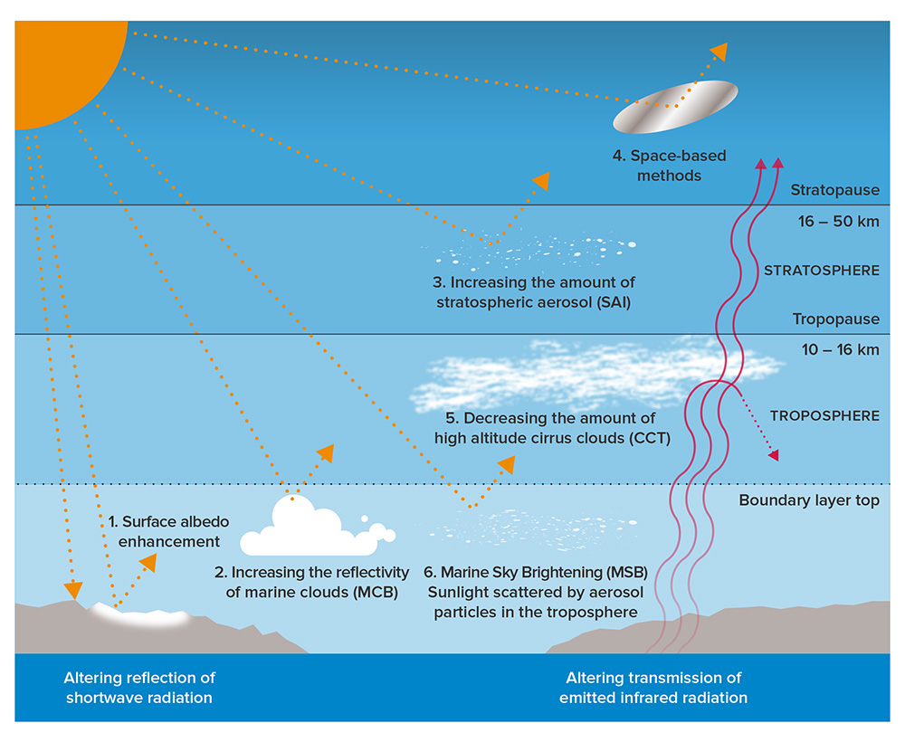
Specific Questions
1. Safer particles than SO2?
Question: are there less dangerous particulates than SO2?
Possible - but no candidate is proven safe enough for deployment.
SO2 makes sulfate aerosols: it is studied because volcanoes give a natural analogue.
Alternatives include calcite (CaCO3), alumina (Al2O3), silica, diamond or TiO2 particles.
The issue shifts rather than disappears: ozone chemistry, particle growth, fallout, toxicity and governance remain uncertain.
SAI masks warming; it does not remove CO2 or stop ocean acidification.

Slide 55
Specific Questions - Scientific
Question: aerosol-cloud interactions.
Aerosols change cloud droplet number, brightness, lifetime and sometimes cloud amount.
More cloud condensation nuclei (CCN) can make more, smaller droplets.
Smaller droplets increase cloud reflectivity and can suppress drizzle.
Absorbing aerosols can heat air and change clouds in the opposite direction.

Slide 56
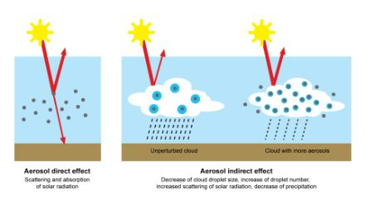
Visibility/Radiative Effects
Aerosols influence climate:
Directly by the scattering and absorption of solar radiation
  The magnitude of the direct forcing of aerosols at a particular time and location depends on the amount of solar radiation scattered back to space, which itself depends on the size and optical properties of the particles, their abundance, and the solar zenith angle

Slide 57
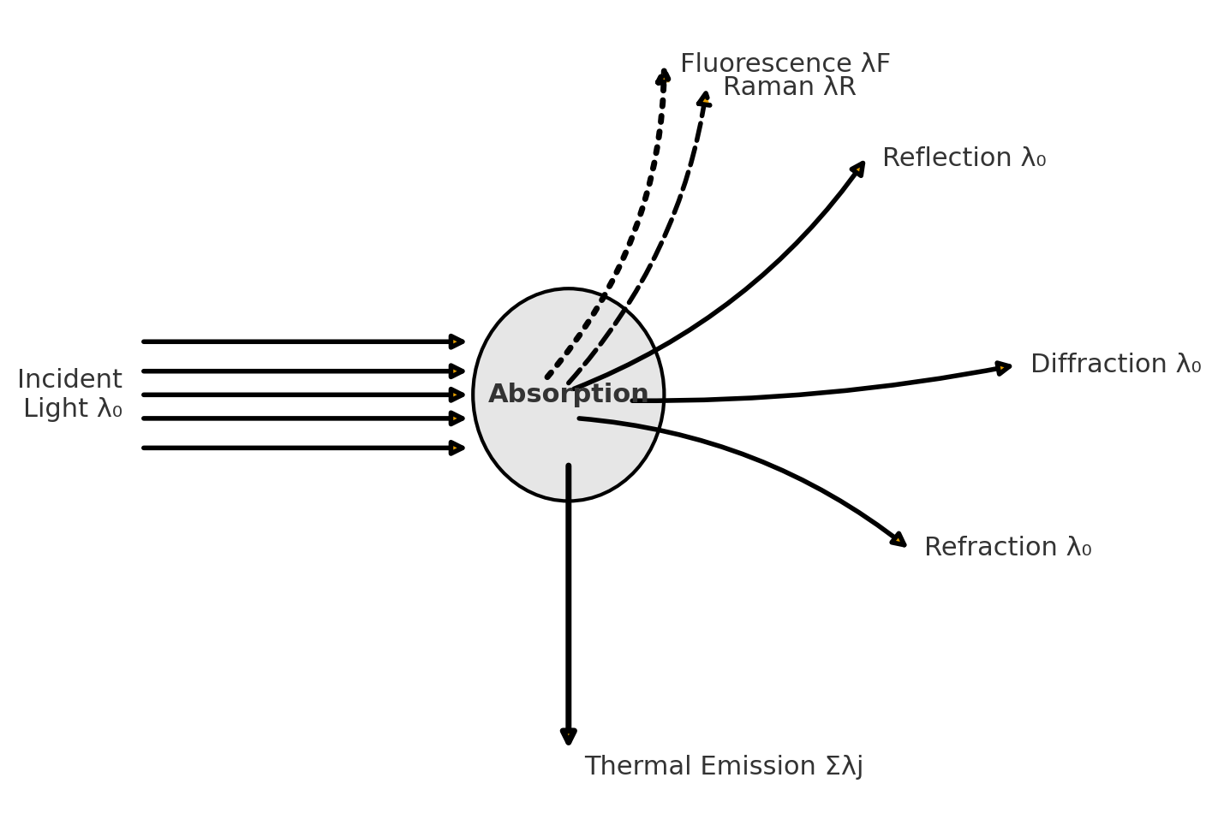
Direct Radiative Forcing…
How particles interact with electromagnetic radiation…
Direct Effect of Aerosols
Seen as sunlight reflected from haze (from above, e.g. mountain/airplane)
Scattering increases planetary reflection (albedo)
Less solar radiation reaches the surface
Same physics as reduced visibility in polluted air masses
Key difference: climate effect arises only from upward-scattered radiation (back to space)

Slide 58
Visibility/Radiative Effects
Aerosols influence climate:
Directly by the scattering and absorption of solar radiation
  The magnitude of the direct forcing of aerosols at a particular time and location depends on the amount of solar radiation scattered back to space, which itself depends on the size and optical properties of the particles, their abundance, and the solar zenith angle
Indirectly through their role as cloud condensation nuclei.
  The indirect effect arises if increases in aerosol number concentrations from anthropogenic sources lead to increased concentrations of cloud condensation nuclei, which, in turn, lead to higher cloud albedo.
The albedo is a measure of reflectivity of a surface or body. It is the ratio of electromagnetic radiation reflected to the amount incident upon it.

Slide 59
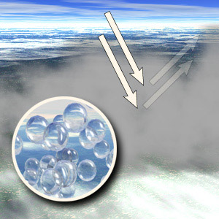
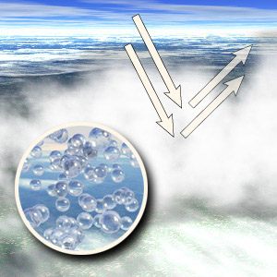
Aerosol Indirect Forcing
Indirect effects refer to how aerosols influence cloud properties, particularly their optical characteristics and lifetime.
Much more complicated than the direct effect and there are two processes important here.
The first indirect effect or Twomey effect describes how an increase in aerosol concentration leads to changes in cloud microphysics:
Increased aerosol concentration means there are more particles available to act as cloud condensation nuclei (CCN), the "seeds" on which cloud droplets form.
More CCN leads to a larger number of smaller cloud droplets. Since the available water vapor is distributed among more droplets, each individual droplet remains smaller than it would otherwise be.
Smaller droplets increase the cloud's reflectivity or albedo (i.e., the amount of sunlight reflected by the cloud back into space) because smaller droplets scatter sunlight more effectively than larger ones.
Fewer and Larger Droplets
Lower Albedo
More small droplets
Higher Albedo

Slide 60
Aerosol Indirect Forcing
Indirect effects refer to how aerosols influence cloud properties, particularly their optical characteristics and lifetime.
Much more complicated than the direct effect and there are two processes important here.
Second Indirect Effect (Cloud Lifetime Effect):
Increased aerosol concentration leads to smaller cloud droplets (Twomey effect)
Smaller droplets are less efficient at coalescing into larger droplets, which are necessary for the formation of rain.
As a result, clouds with more aerosols have smaller droplets that remain suspended in the atmosphere longer, delaying or reducing rainfall.
Longer Cloud Lifetime
Increased Cloud Coverage
Reduced Precipitation
Fewer and Larger Droplets
Lower Albedo
More small droplets
Higher Albedo

Slide 61
Surface Albedo…
NB the sign of the aerosol forcing depends on the underlying surface albedo
Dark, low albedo ocean Light, high albedo ice

Slide 62
Surface Albedo…
NB the sign of the aerosol direct forcing depends on the underlying surface albedo
Dark, low albedo ocean Light, high albedo ice
Increase
Reduction
Cloud

Slide 63
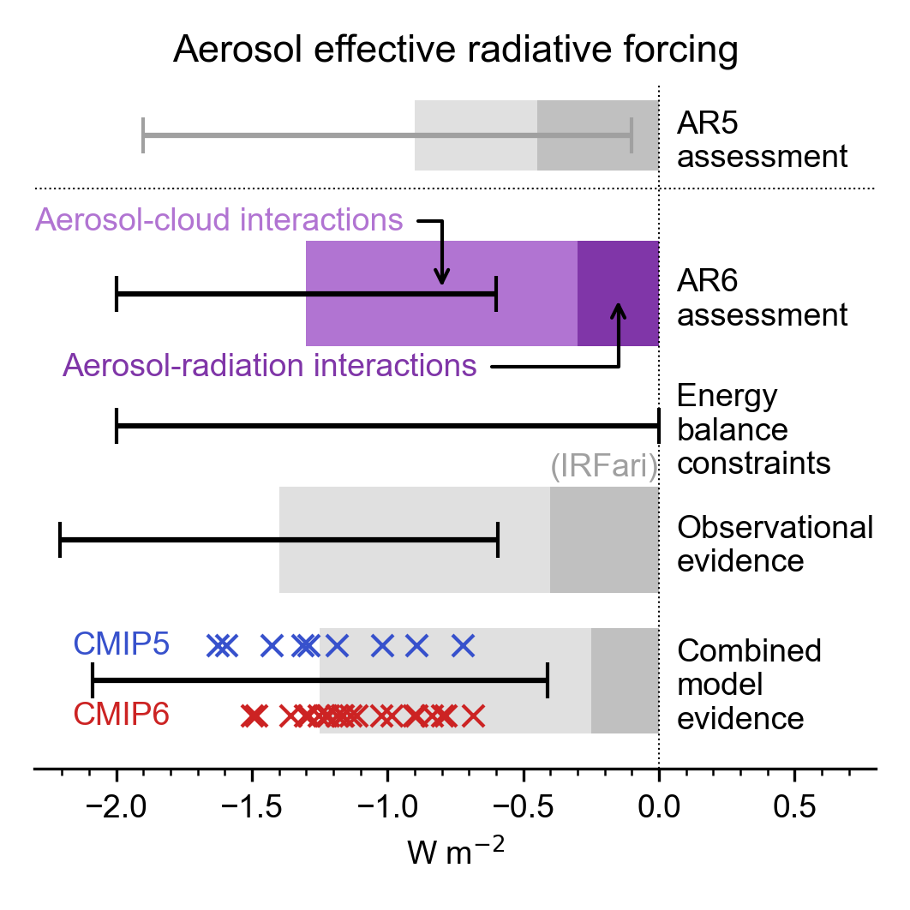
Specific Questions - Scientific
Why are aerosol-cloud error bars so large?
Question: what are the error sources / unknowns?
The sign is cooling, but the strength is hard to pin down.
Aerosols are short-lived and patchy, unlike well-mixed CO2.
The pre-industrial aerosol baseline is uncertain.
Cloud droplet number, liquid water, precipitation and meteorology are coupled.
Satellites struggle with aerosol-cloud vertical overlap and causality.
Models use different aerosol sizes, compositions and cloud microphysics.

Slide 64
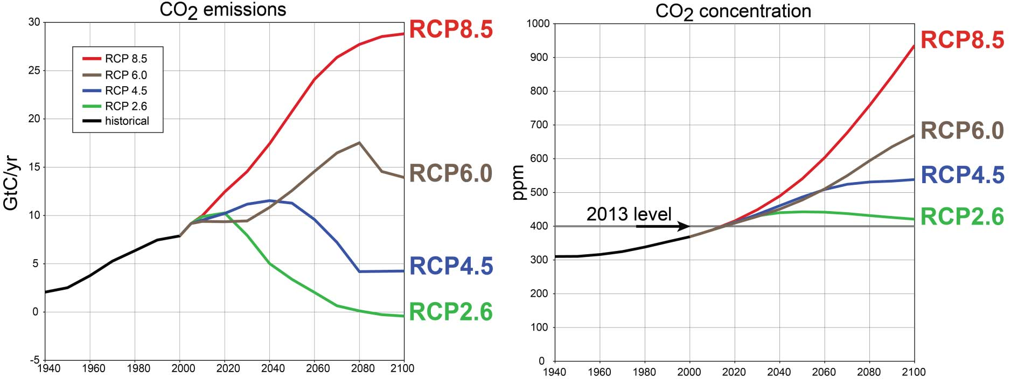
RCP CO2 scenarios
RCP labels are 2100 radiative forcing targets/pathways, not predictions.
• RCP2.6: strong mitigation; emissions fall rapidly and approach net zero / net negative.
• RCP4.5 and RCP6.0: stabilisation pathways with later or weaker mitigation.
• RCP8.5: high-end pathway with emissions continuing to rise through much of the century.
• The graph shows divergence: choices about emissions now shape CO2 concentration and forcing later.
Remember: RCP8.5 is useful as a high-end sensitivity case, not a guaranteed future.

Slide 65
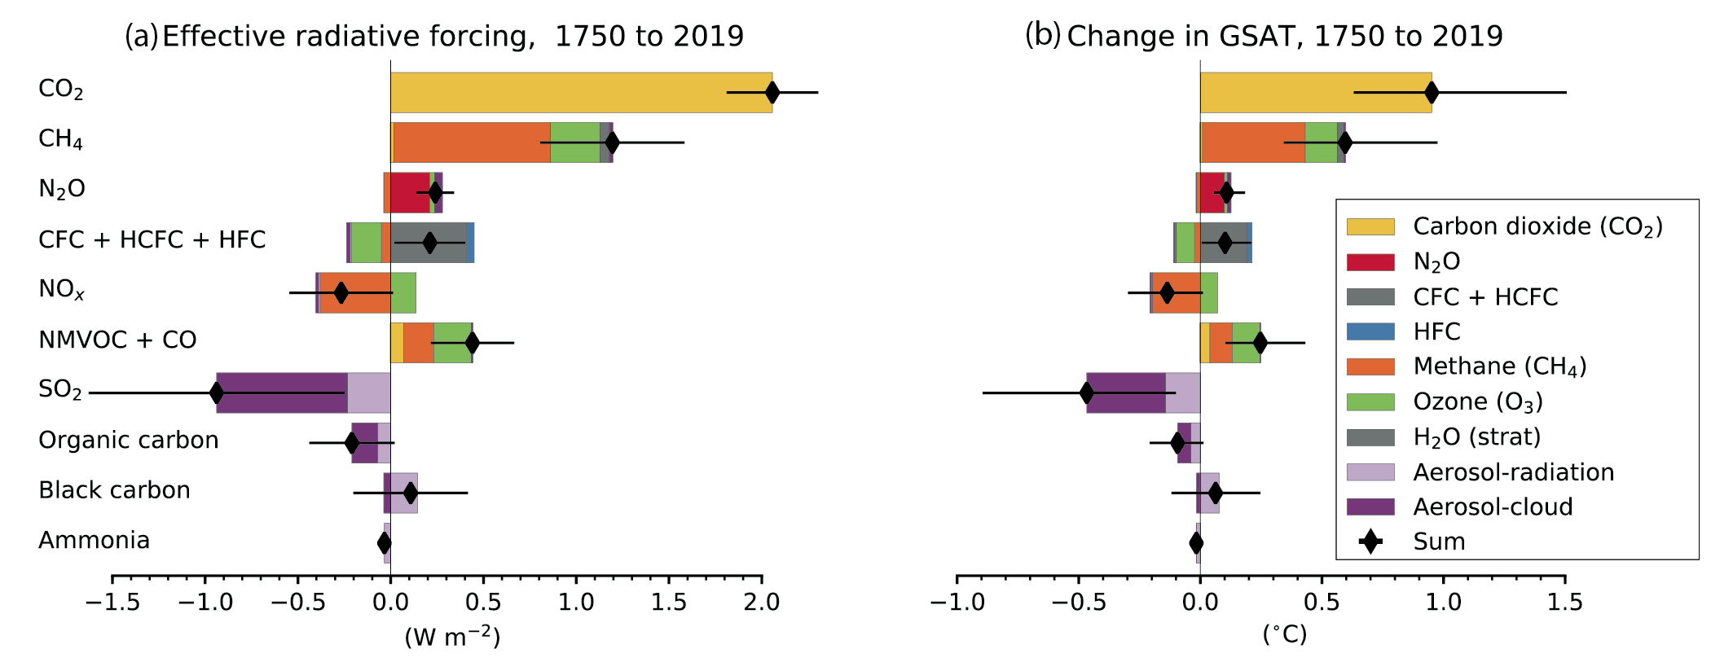
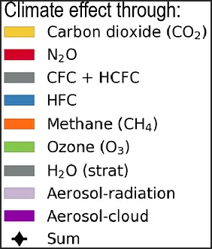
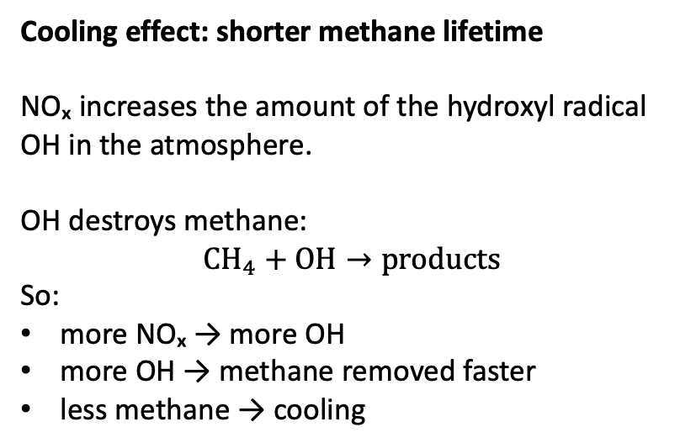
Methane Cooling with NOx
Questions: methane cooling with NOx
Cooling effect: shorter methane lifetime
NOₓ increases the amount of the hydroxyl radical OH in the atmosphere.
OH destroys methane:
$$CH_{4}+OH→products$$
So:
more NOₓ → more OH
more OH → methane removed faster
less methane → cooling
NOx row: O3 warming + CH4 cooling

Slide 66
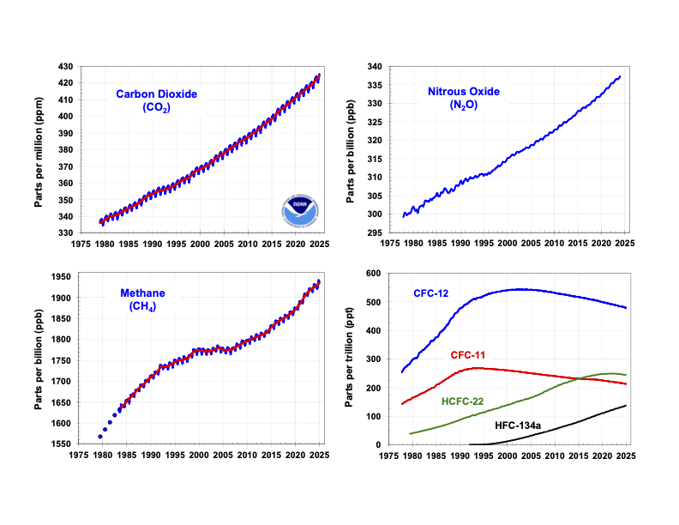
Specific Questions - Scientific
6. CFC / HCFC / HFC: phased out, but not gone
Question: are they still a global problem?
Yes - controlled successfully, but long-lived gases
CFCs: production phased out; atmospheric levels are declining but they persist for decades.
HCFCs: transitional substitutes; many have peaked or are now declining under controls.
HFCs: do not destroy ozone, but many are strong greenhouse gases
Montreal Protocol worked, but the climate legacy has not vanished, much like the GHGs

Slide 67
Some exam advice….
Week 1 – Climate Change and its Impacts
Week 2 – Natural Climate Variability
Week 3 – Radiation Law/Greenhouse Effect
Week 4 – Anthropogenic Impacts
Week 5 – The Evidence Base
Week 7 – Climate Models
Week 8 – Climate Change Adaptation
Week 9 – Climate Change Mitigation
Week 10 – Climate Engineering

Slide 68
Some exam advice….
Write Clearly: Ensure your handwriting is legible. If I can’t read your answer, I can’t give you marks!
Read the Questions Carefully: Take your time to understand what each question is asking.
Use Example Questions and Workshop Questions: Practice using the example and workshop questions provided in class.
Manage Your Time: Allocate enough time to each question. There are 5. Total 75 marks
Use Units Properly: Always check that you are using the correct units
If You Need Help, Email Me: If you have any last-minute questions or need clarification on anything, don’t hesitate to reach out via email. I’m happy to help.

Slide 69
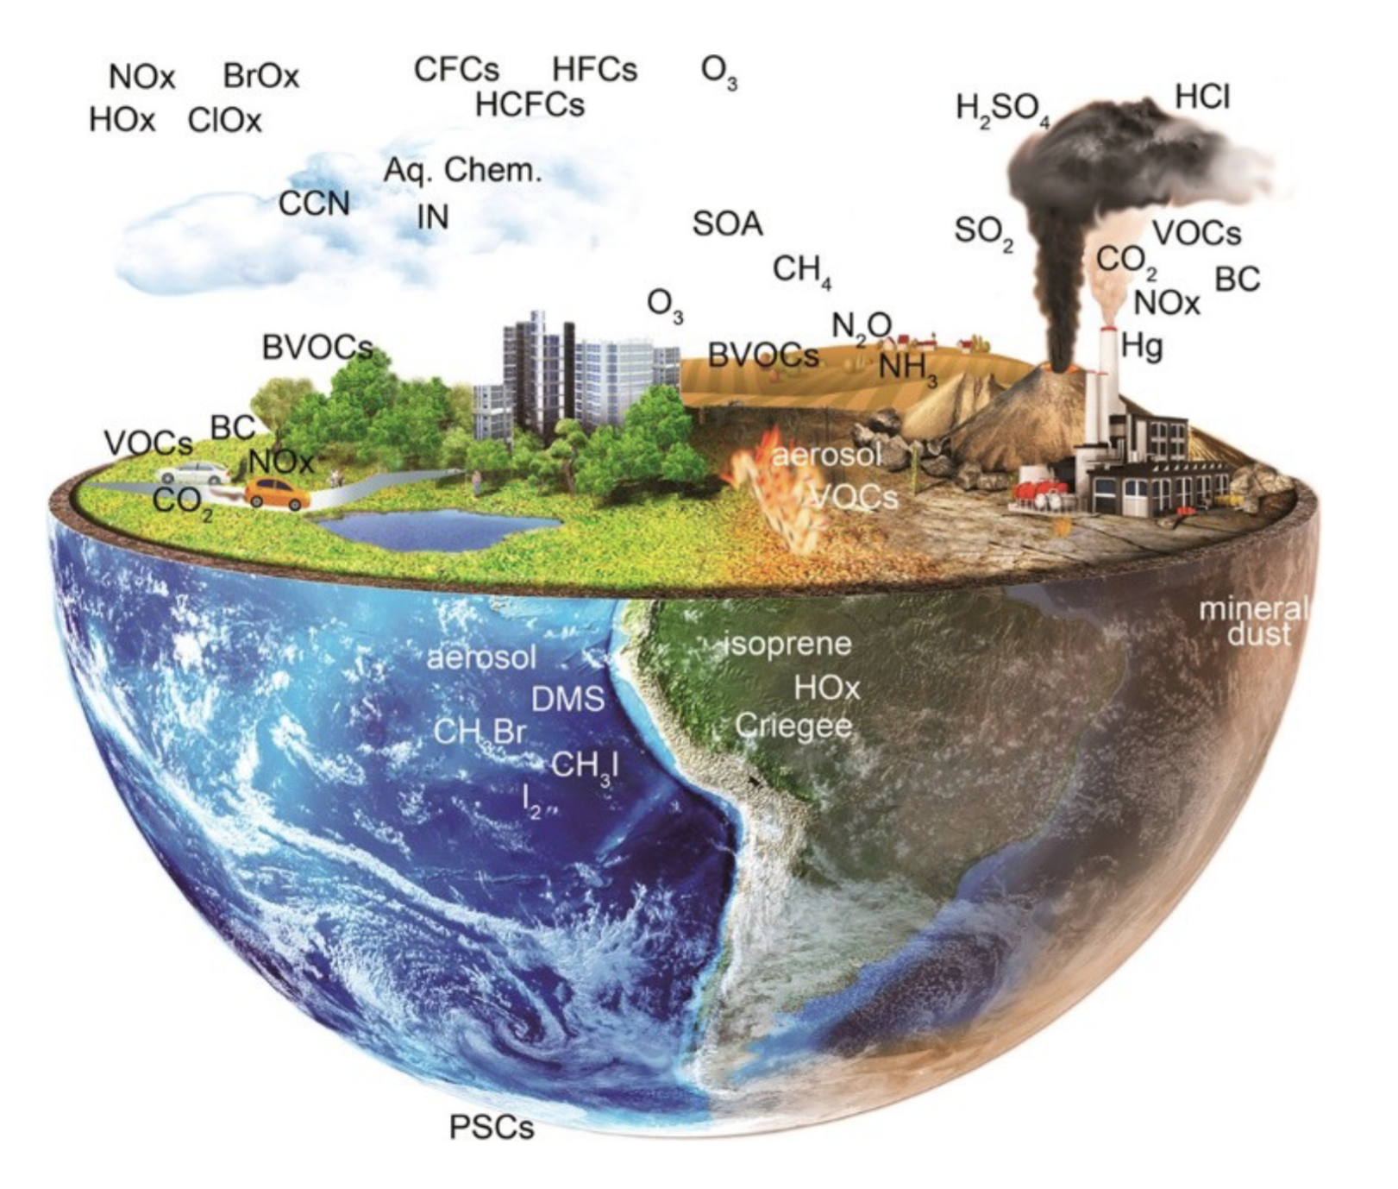
Finally, 3rd year options:
EART35001: Atmospheric Composition
EART36002: Climate and Energy

Slide 70

Q&A

Slide 71

Thank you

